Slide 1
Conversation About Cooperative Audit Resolution (CAROI) and its successful implementation in Puerto Rico
Ileana Fas Pacheco
Phil Maestri

Slide 2
Agenda
Background
Actions taken
What is CAROI
Accomplishments
Relevance of CAROI today
Questions

Slide 3
What happened
Notes:
Culmination of many years of unresolved audits
Hundreds of findings
Millions $$$ questioned costs
Potential fraud and abuse
Problems bigger than PRDE
High risk designation the only answer

Slide 4
Cronologia de Eventos
PRDE es declarado "High Risk Grantee" | May-2002
50% fondos del 2002-03 son congelados | May-2002
PRDE entra en el proceso CAROI | Sep-2003
“Agreed Upon Procedure” | Feb-2004
Comienzo Planes de Trabajo | Mar-2004
100% de los fondos 2004-05 otorgados a tiempo | Aug-2004
Implementación de módulos Grant y Project de PRIFAS | Aug-2004
Recuperación de fondos disponibles del 1998-99 + 1999-00 | Sep-2004
Acuerdo de Cumplimiento | Oct-2004
Eliminación de la designación de "High Risk Grantee" | Oct-2004

Slide 5
Señalamientos del 1994 al 2003 Single Audit + OIG

Slide 6
Costos Cuestionados del 1994 al 2003 $151,258,732

Slide 7
Cronologia de Eventos
PRDE es declarado "High Risk Grantee" | May-2002
50% fondos del 2002-03 son congelados | May-2002
PRDE entra en el proceso CAROI | Sep-2003
“Agreed Upon Procedure” | Feb-2004
Comienzo Planes de Trabajo | Mar-2004
100% de los fondos 2004-05 otorgados a tiempo | Aug-2004
Implementación de módulos Grant y Project de PRIFAS | Aug-2004
Recuperación de fondos disponibles del 1998-99 + 1999-00 | Sep-2004
Acuerdo de Cumplimiento | Oct-2004
Eliminación de la designación de "High Risk Grantee" | Oct-2004

Slide 8
en los viejos tiempos…
Audit resolution was battle.
Findings
Led to disagreements
Then appeals , distrust, secrecy,
Everyone had to take “sides”

Slide 9
Audit Process
Costly to produce
Questions spending of Federal funds
Expensive to defend
Same findings next year
Notes:
We were talking single audits but any audit could fit the pattern
Always a disagreement over the spending of funds
Practice was to never admit there was a problem – deny and defend
Lawyers and litigation very frequent
Because we were focused on the specific findings the basic problem was never fixed

Slide 10
And then…
Cesar Rey was instrumental in change
Willing to admit there were problems
Had the courage to trust USDE to not use what PRDE revealed against them
Was an advocate for infrastructure reform
Became an excellent partner
Brought with him Ileana Fas and many competent team members

Slide 11
CAROI Proverb
“…usted no necesita un martillo para quitar una mosca de la cabeza de otro…”
Ancient Proverb
Notes:
usted no necesita un martillo para quitar una mosca de la cabeza de otro
That was our approach – everything needed a sledgehammer
In reality, 80% could be resolved with minimal effort – everybody agreed on findings

Slide 12
Five Part Formula for Success
+Right Players
+Open Dialogue
+Shared Purpose/Objectives
+Sense of Urgency
+Seeing Things Differently
=Successful resolution
Notes:
If you had anything to do with the process/audit/resolution you need to be at the table
Solutions were much easier to find when it was a discussion rather than a letter writing campaign
Amazing – we were all in the same business – and it had nothing to do with finance or …
Feeling a need to resolve this so we can all get back to the REAL work.
Recognizing there is more than one right answer – and the Feds frequently don’t have that answer

Slide 13
Why does it work?
Audits become a useful management tool
Burden of resolving audits and correcting problems is reduced
Communication and understanding increases
Notes:
How do we know when we’re there?
Audits are no longer looked at as a problem to be dealt with but rather a help to identify areas to improve
The process of resolving gets easier
Everybody is talking – for the right reasons

Slide 14
Advantages of CAROI
Broad Applicability
Cost Savings
Flexibility
Impartiality
Efficiency
Accountability
Notes:
We’ve used this lots of places.
Not just a one time project
Started in PA.
Several states
Maryland used with Baltimore
USDE incorporates CAROI principles into all audit resolution
There is hope for you

Slide 15
CAROI Principles
Communication
Understanding
Trust
Sharing
Collaboration
Resolution/performance
Notes:
Talking WITH each other – not just AT each other
Seeing other perspectives as valid
Behave as though you are trusted and that you’re worthy of that trust
Working together is best: Rod Paige – “None of us individually are as smart as ALL of us together!”
Get to the solution that improves the program delivery

Slide 16
Every CAROI project should end with
Performance goal/objective
Solution to root causes – systemic change
Project plan to achieve goals
Identifies
Stakeholders
Accountabilities and responsibilities
Resources
An agreement signed by all parties
Notes:
Identified what it is that we’re trying to accomplish
How do we do that?
Who will do it?
Who is responsible for success/failure?
What do we need to get it done?
Everybody agrees AND commits

Slide 17
Cronologia de Eventos
PRDE es declarado "High Risk Grantee" | May-2002
50% fondos del 2002-03 son congelados | May-2002
PRDE entra en el proceso CAROI | Sep-2003
Agreed Upon Procedure | Feb-2004
Comienzo Planes de Trabajo | Mar-2004
100% de los fondos 2004-05 otorgados a tiempo | Aug-2004
Implementación de módulos Grant y Project de PRIFAS | Aug-2004
Recuperación de fondos disponibles del 1998-99 + 1999-00 | Sep-2004
Acuerdo de Cumplimiento | Oct-2004
Eliminación de la designación de "High Risk Grantee" | Oct-2004

Slide 18
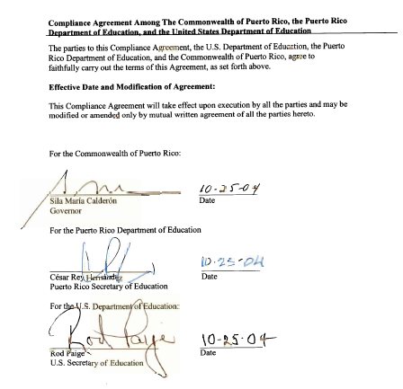
Signed Compliance Agreement

Slide 20
Results – Lapsed Funds

Slide 21
Resultados "Single Audits" del 1994 al 2004

Slide 22
Omni-crcular
2 CFR 200
Strengthens oversight of Federal grants
Common standards for financial and program management
Encourages the use of CAROI
Notes:
So, why do we care about the Omni-circular in a CAROI discussion?
Because CAROI is now in the new regulations – government wide regulations.

Slide 23
Relevance of CAROI Today
New OMB omni-circular (§ 200.513 ©(3)(iii) and § 200.25 Cooperative Audit Resolution);
Broad Applicability;
Local experience developed within PR;
Provides a framework for problem solving;
Can be applied in local multi-agency issues;
Addresses root causes of problems.
Notes:
Still lots left to be done
Have come a long way since we started
Without the improvements implemented through CAROI would not be ready to make other improvements
Program first but with broken infrastructure can’t focus on program delivery

Slide 24
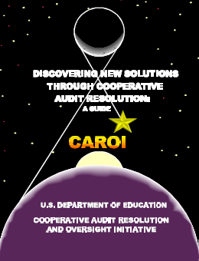
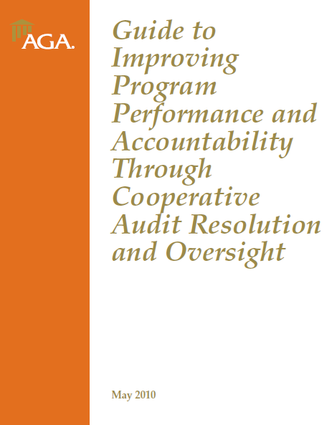
CAROI Guides
http://www2.ed.gov/policy/gen/guid/caroi/index.html
http://www.agacgfm.org/AGA/ToolsResources/documents/CAROI.pdf
Notes:
Two guides for implementing CAROI
1st ED original handbook
2nd AGA toolkit
Google CAROI

Slide 25
Thank You
Preguntas?

